Slide 1

18CSC203J – COMPUTER ORGANIZATION AND ARCHITECTURE
UNIT-III
Course Outcome
CLR-3: Understand the concepts of Pipelining and basic processing units
CLO-3 : Analyze the detailed operation of Basic Processing units and the performance of Pipelining

Slide 2
Topics Covered
Fundamental concepts of basic processing unit
Performing ALU operation
Execution of complete instruction, Branch instruction
Multiple bus organization
Hardwired control,
Generation of control signals
Micro-programmed control, Microinstruction
Micro-program Sequencing
Micro instruction with Next address field
Basic concepts of pipelining
Pipeline Performance
Pipeline Hazards-Data hazards, Methods to overcome Data hazards
Instruction Hazards
Hazards on conditional and Unconditional Branching
Control hazards, Influence of hazards on instruction sets

Slide 3
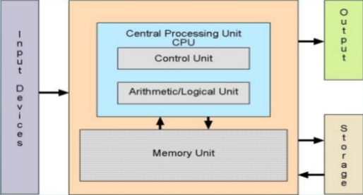
PROCESSING UNIT
FUNCTIONS OF CPU:
CPU carries out all forms of data processing tasks.
It saves information, intermediate results and instructions.
CPU monitors the functionality of all computer components.
COMPONENTS OF CPU:
Memory or storage unit: The memory unit stores all the instructions and data. This unit provides data to other units of the computer if necessary. Also known as main memory, or RAM (Random Access Memory).
Control unit: This unit monitors all computing processes but does not execute actual data processing.
Arithmetic Logic Unit (ALU): This does all the calculations and makes the decisions.

Slide 4
FUNDAMENTAL CONCEPTS OF BASIC PROCESSING UNIT
Processor fetches one instruction at a time and perform the specified operation.
Instructions are fetches from successive memory locations except for branch/ jump instruction.
The address of the next instruction to be executed is tracked by the Program Counter (PC) register.
Instruction Register (IR) contains instruction that is currently executed.
Instruction execution happens in three phases:
Fetch: Fetch the instruction from the specified memory
Decode: Determined the opcode and the operands
Execute: Run the instruction

Slide 5
EXECUTING AN INSTRUCTION
Fetch the contents of memory location pointed by the PC. The contents of this memory location is loaded to the IR-Fetch phase
IR← [[PC]]
Increment the PC by 4 (assume the word size as 4 )
PC←[PC]+4
Carry out the actions specified by the instruction in the IR-Execution phase
Datapath: collection of functional units such as ALU or multipliers that perform data processing operations.
MDR: Two inputs and two outputs since data can be loaded from memory or processor bus.
MAR: Input line is connected to internal bus and output line to external bus
Control lines: Cto instruction decoder and control logic block to issue control signals
R0-R(n-1): General Purpose registers whose numbers vary between processors.
TEMP, Y and Z: Temporary registers used by the processor during instruction execution

Slide 6
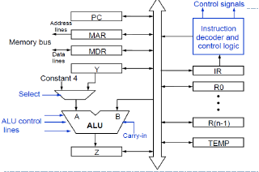
Fig : Single bus organization of datapath

Slide 7
EXECUTING AN INSTRUCTION
Transfer a word of data from one processor register to another or to the ALU
Perform Arithmetic and Logic operation and store the result in processor register
Fetch the contents of a given memory location and load the, into processor register.
Store a word of data from a processor register into a given memory location
REGISTER TRANSFERS
For each register two control signals are used :
To place the contents of that register on the bus
To load the data on the bus into register
The input and output of register are connected to the bus through switches controlled by the signals Rin and Rout.

Slide 8
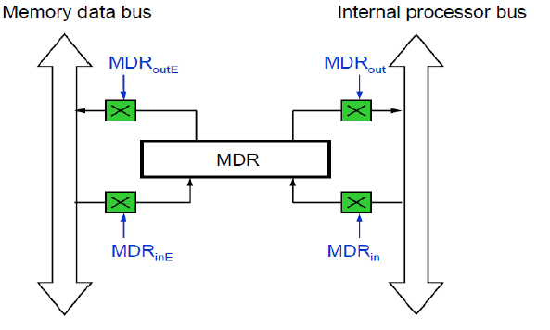

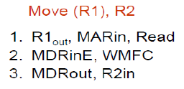
PERFORMING AN ARITHMETIC OR LOGIC OPERATION
The ALU is a combinational circuit that has no internal storage.
ALU gets the two operands from MUX and bus. The result is temporarily stored in register Z.
The sequence of operations to add contents of R1 and R2 and store it in R3:
FETCHING WORD FROM MEMORY
Address will be loaded into MAR from PC
Read operation will be issued in the bus and the data will be loaded into MDR.
Wait for Memory Function Completed (WMFC): This signal is issued to make the processor to wait for the reply from the memory (MFC ).
Fig: Fetching word form Memory

Slide 9
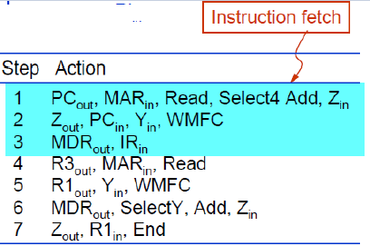
EXECUTION OF COMPLETE INSTRUCTION
Initiate instruction fetch by loading contents of PC to MAR.
Send Read request to memory.
Incrementing PC
Contents of PC is loaded to register B.
Set select signal to 4, which make multiplexer to select const 4, which is then added to B. The result is available in Z.
The content of Z is loaded to PC.
Load IR
The word is fetched from the memory and loaded into IR
Decoding: Instruction decoding circuit interprets contents of IR.
Execution: Control circuitry is activated to issue relevant control signals.
Load MAR with contents of R3. Initiate memory read. Transfer R1 to Y.
ADD (R3), R1
Perform addition on Y and MDR after selecting Y.
Load the result from Z to R1.

Slide 10
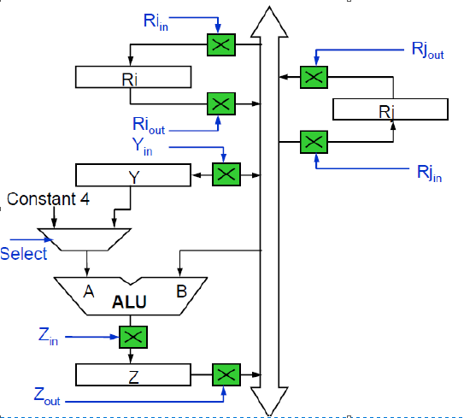
SIGNAL DIAGRAM

Slide 11
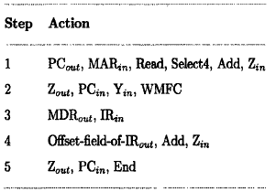
EXECUTION OF BRANCH INSTRUCTIONS
Branch instruction replaces the contents of PC with the branch target address, which is usually obtained by adding an offset X given in the branch instruction.
The offset X is usually the difference between the branch target address and the address immediately following the branch instruction.
Two types of branch: conditional and unconditional branch
Unconditional Branch:
Offset value : branch target address –address immediately following the branch instruction.
Offset value is obtained from IR and is available in X.
Y contains the updated PC value. Add the offset address along with PC to find the branch target.
Now load the calculated branch target from Z to PC.

Slide 12
EXECUTION OF CONDITIONAL BRANCH
Check status of condition codes before loading branch target into PC
Condition Codes
The CPU maintains a set of single-bit condition code registers.
These registers are set by arithmetic and logical operations and can be tested to perform conditional branches.
Examples:
Carry flag. If set, the most recent operation generated a carry out of the most significant bit. Use to detect overflow for unsigned operations.
Zero flag. The most recent operation yielded zero.
Sign flag. The most recent operation yielded a negative value.
Overflow flag. The most recent operation caused a two’s complement overflow – either negative or positive.
Branch on negative
If N=0 then the processor return to step 1 after step 4.
If N=1 then load a new value into PC to perform branching.

Slide 13
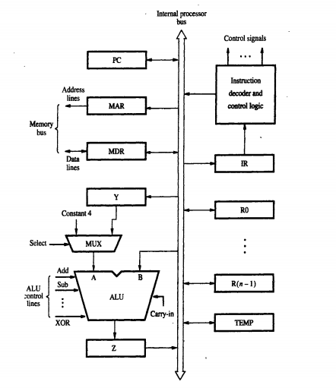
SINGLE BUS ORGANISATION OF A DATAPATH

Slide 14
MULTIPLE BUS ORGANIZATION
Single bus structure takes long time for transfer of data in a clock cycle
To avoid the above said process ,multiple internal paths are enabled in commercial processors .
This allows to have several transfers to take place in parallel

Slide 15
Multi Bus
The next slide has the three bus structure which is connecting registers and the ALU of processors
Register file: is a single block of all general purpose registers
Register file has three ports.
First Two output ports are connected to different registers placed on the Bus A and Bus B.
One more third port connected to Bus C during the same clock cycle.

Slide 16
Cont…
Buses A and B used to Transfer the source operands to A and B inputs of ALU.(Arithmetic and logic operations are performed)
The result is transferred over the Bus C.
Three bus arrangement avoids the usage of registers Y and Z.
Incrementer Unit: is used to increment the PC by 4 which eliminates the usage of ALU.

Slide 17
Cont…
It increments the other addresses such as the memory addresses in LoadMultiple and StoreMultiple instructions.
Three operand instruction
Add R4,R5,R6
STEP1: The contents of the PC are passed through the ALU using R=B control signal and loaded into MAR for(Memory Read operation) and the PC is incremented by 4

Slide 18
Cont..
Step2: The processor waits for MFC (WMFC-Wait for Memory Function completed)
STEP3: MFC loads the data received into MDR. And again data is transferred into IR
STEP4: Final execution phase requires only one control step
Providing more paths for data transfer results in reduction of clock cycles needed to execute an instruction.

Slide 19
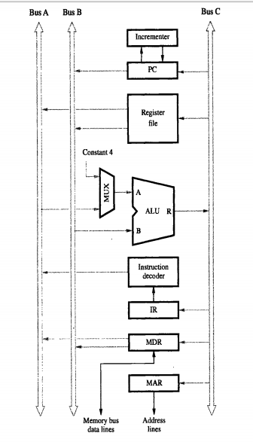
MULTIPLE BUS ORGANISATION

Slide 20
Multiple-Bus Organization
Add R4, R5, R6
Step
Action
1
PC
out
,
R=B,
MAR
in
,
Read,
IncPC
2
WMF
C
3
MDR
outB
,
R=B,
IR
in
4
R4
outA
,
R5
outB
,
SelectA,
Add,
R6
in
,
End
Figure 7.9. Control sequence for the instruction. Add R4,R5,R6,
for the three-bus organization in Figure 7.8.

Slide 21
Hardwired Control

Slide 22
Overview
To execute instructions, the processor must have some means of generating the control signals needed in the proper sequence.
Two categories: hardwired control and microprogrammed control
Hardwired system can operate at high speed; but with little flexibility.

Slide 23
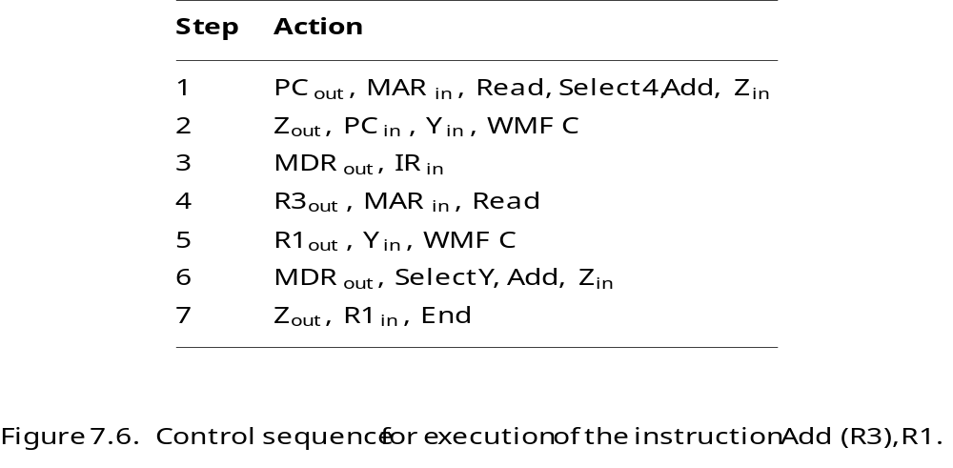
7 Steps:

Slide 24
Cont…
The before slide depicts the sequence of control signals
Every step is completed in one clock period
Counter is used to keep track of the control steps.
Control signals are determined by following information
Contents of the control step counter
Contents of instruction register
Contents of condition code flags
External input signals, such as MFC and interrupt requests

Slide 25
Decoder/encoder block
Is a combinational circuit that generates the required control outputs depending on the state of all its input.
The control unit organization of the decoder and encoder block is shown in the next slide

Slide 26
Control Unit Organization
Clock
CLK
Control step
counter
External
inputs
Decoder/
IR
encoder
Condition
codes
Control signals
Figure 7.10. Control unit organization.

Slide 27
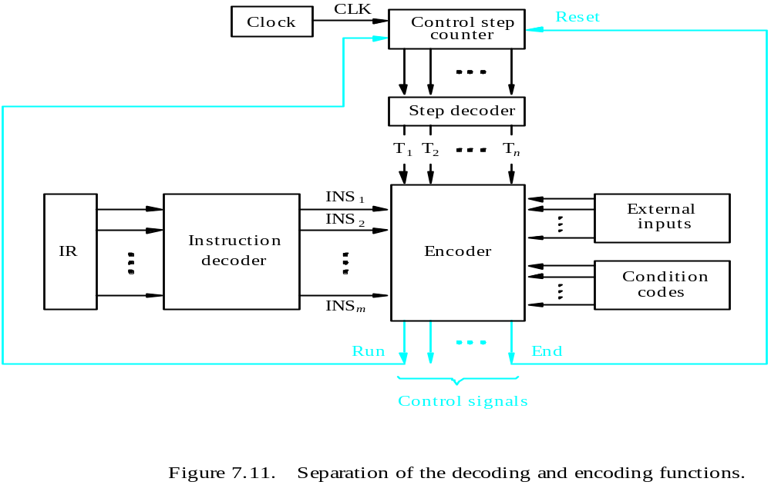
Detailed Block Description

Slide 28
Explanation of decoding and encoding
The step decoder provides a separate signal signal line for each step or time slot in the control sequence
Output of the instruction decoder consists of separate line for each machine instruction.
Any instruction loaded into IR,one of the output lines INS1 trough INSm is set to 1 and all others are set to 0.
The input signals to the encoder are combined to generate individual control signals Yin,PCout

Slide 29
Generating Z_{in}
Z_{in} = T₁ + T₆ • ADD + T₄ • BR + …
The signal is asserted during time slot T1 for all instruction ,T6 for an ADD instruction ,T4 for unconditional branch instruction
Branch
Add
T
4
T
6
T
1
Figure 7.12. Generation of the Z_{in} control signal for the processor in Figure 7.1.

Slide 30
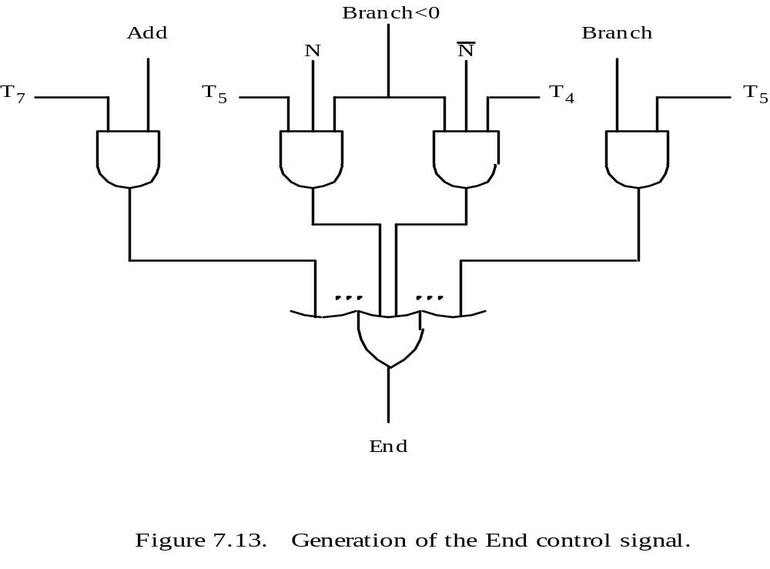
Generating End
End = T₇ • ADD + T₅ • BR + (T₅ • N + T₄ • N) • BRN +…

Slide 31
End signal
End signRal starts a new instruction fetch cycle by resetting the control step counter to its starting value.
Control signal called RUN.
RUN set as 1 ,causes the counter to be incremented by one at the end of every clock cycle.
RUN equal to 0 , the counter stops counting
WMFC signal is issued to cause the processor to wait for the reply from memory

Slide 32
Cont…
These control unit organization viewed as state machine(one state to another in every clock cycle)
Output of the state machines are control signals.
Sequence of operations carried out by machine is determined by the wiring of logic elements,hence the name “hardwired”.
Controller operates at high speed

Slide 33
Complete Processor
This structure has instruction unit that fetches from instruction cache or from the main memory.
Processing unit to handle integer and floating point data.
Data cache is introduced between these units and main memory
Separate cache for instruction and data
Processor is connected to system bus.
Bus interface is used to connect to rest of memory and input output unit.

Slide 34
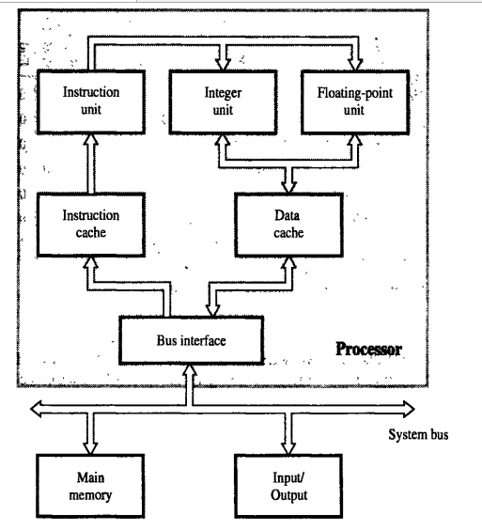
Complete Processor

Slide 35
Microprogrammed Control
A control unit whose binary control variables are stored in memory is called a micro programmed control unit.

Slide 36
Microprogrammed Control Unit
Control signals
  Group of bits used to select paths in multiplexers, decoders, arithmetic logic units
Control variables
  Binary variables specify microoperations
    Certain microoperations initiated while others idle
Control word
  String of 1’s and 0’s represent control variables

Slide 37
Microprogrammed Control Unit
Control memory
  Memory contains control words
Microinstructions
  Control words stored in control memory
  Specify control signals for execution of microoperations
Microprogram
  Sequence of microinstructions

Slide 38
Control Unit Implementation
Hardwired
Memory
Instruction code
Sequence Counter
Combinational
.
.
Control
signals
Logic Circuits
Micro programmed
CAR: Control Address Register
CDR: Control Data Register
Memory
Instruction code
Next Address
Control
Memory
Decoding
Circuit
.
.
Control
signals
Generator
(sequencer)
CAR
CDR

Slide 39
Control Memory
Read-only memory (ROM)
Content of word in ROM at given address specifies microinstruction
Each computer instruction initiates series of microinstructions (microprogram) in control memory
These microinstructions generate microoperations to
  Fetch instruction from main memory
  Evaluate effective address
  Execute operation specified by instruction
  Return control to fetch phase for next instruction
Control memory (ROM)
Address
Control word (microinstruction)

Slide 40
Micro programmed Control Organization
External
input
Next Address
Control
Memory
(ROM)
Generator
(sequencer)
CAR
CDR
Control
word
Control memory
  Contains microprograms (set of microinstructions)
  Microinstruction contains
    Bits initiate microoperations
    Bits determine address of next microinstruction
Control address register (CAR)
  Specifies address of next microinstruction

Slide 41
Microprogrammed Control Organization
Next address generator (microprogram sequencer)
  Determines address sequence for control memory
Microprogram sequencer functions
  Increment CAR by one
  Transfer external address into CAR
  Load initial address into CAR to start control operations

Slide 42
Microprogrammed Control Organization
Control data register (CDR)- or pipeline register
  Holds microinstruction read from control memory
  Allows execution of microoperations specified by control word simultaneously with generation of next microinstruction
Control unit can operate without CDR
External
input
Next Address
Control
Memory
(ROM)
Generator
(sequencer)
CAR
Control
word

Slide 43
Microinstruction Sequencing:
A micro-program control unit can be viewed as consisting of two parts:
The control memory that stores the microinstructions.
Sequencing circuit that controls the generation of the next address.

Slide 44
Microinstruction Sequencing:
A micro-program sequencer attached to a control memory inputs certain bits of the microinstruction, from which it determines the next address for control memory. A typical sequencer provides the following address-sequencing capabilities:
Increment the present address for control memory.
Branches to an address as specified by the address field of the micro instruction.
Branches to a given address if a specified status bit is equal to 1.
Transfer control to a new address as specified by an external source (Instruction Register).
Has a facility for subroutine calls and returns.

Slide 45
Microinstruction Sequencing:
Depending on the current microinstruction condition flags, and the contents of the instruction register, a control memory address must be generated for the next micro instruction.
There are three general techniques based on the format of the address information in the microinstruction:
Two Address Field.
Single Address Field.
Variable Format

Slide 46
Two address field
The simplest approach is to provide two address field in each microinstruction and multiplexer is provided to select:
Address from the second address field.
Starting address based on the OPcode field in the current instruction.
The address selection signals are provided by a branch logic module whose input consists of control unit flags plus bits from the control partition of the micro instruction.

Slide 47
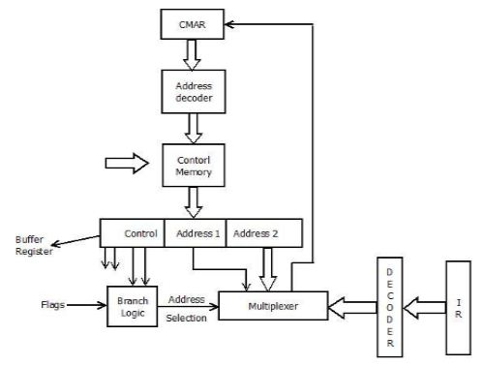
Two Address Field

Slide 48
Single address field
Two-address approach is simple but it requires more bits in the microinstruction. With a simpler approach, we can have a single address field in the micro instruction with the following options for the next address.
Address Field.
Based on OPcode in instruction register.
Next Sequential Address.
enter image description here
The address selection signals determine which option is selected. This approach reduces the number of address field to one. In most cases (in case of sequential execution) the address field will not be used. Thus the microinstruction encoding does not efficiently utilize the entire microinstruction.

Slide 49
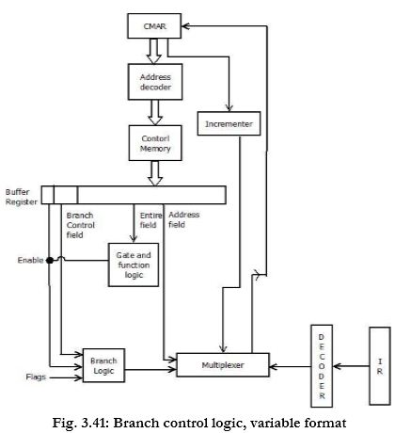
Single address field

Slide 50
Variable Format
In this approach, there are two entirely different microinstruction formats. One bit designates which format is being used. In this first format, the remaining bits are used to activate control signals.
In the second format, some bits drive the branch logic module, and the remaining bits provide the address. With the first format, the next address is either the next sequential address or an address derived from the instruction register. With the second format, either a conditional or unconditional branch is specified.

Slide 51
Variable Format

Slide 52
Address Sequencing
Address sequencing capabilities required in control unit
  Incrementing CAR
  Unconditional or conditional branch, depending on status bit conditions
  Mapping from bits of instruction to address for control memory
  Facility for subroutine call and return

Slide 53
Address Sequencing
Instruction code
Mapping
logic
Status
bits
Branch
MUX
Multiplexers
logic
select
Subroutine
Register
(SBR)
Control Address Register
(CAR)
Incrementer
Control memory (ROM)
select a status
bit
Branch address
Microoperations

Slide 54
Microprogram Example
MUX
Computer
Configuration
10
0
AR
Address
Memory
10
0
2048 x 16
PC
MUX
6
0
6
0
15
0
DR
SBR
CAR
Control memory
Arithmetic
logic and
shift unit
128 x 20
Control unit
15
0
AC

Slide 55
Microprogram Example
Computer instruction format
15
14
11
10
0
I
Opcode
Address
Four computer instructions
Symbol OP-code Description
EA is the effective address
  ADD 0000 AC ← AC + M[EA]
  BRANCH 0001 if (AC < 0) then (PC ← EA)
  STORE 0010 M[EA] ← AC
  EXCHANGE 0011 AC ← M[EA], M[EA] ← AC
Microinstruction Format
3
3
3
2
2
7
F1
F2
F3
CD
BR
AD
F1, F2, F3: Microoperation fields
CD: Condition for branching
BR: Branch field
AD: Address field

Slide 56
Microinstruction Fields
F1 Microoperation Symbol
000 None NOP
001 AC ← AC + DR ADD
010 AC ← 0 CLRAC
011 AC ← AC + 1 INCAC
100 AC ← DR DRTAC
101 AR ← DR(0-10) DRTAR
110 AR ← PC PCTAR
111 M[AR] ← DR WRITE
F2 Microoperation Symbol
000 None NOP
001 AC ← AC - DR SUB
010 AC ← AC ∨ DR OR
011 AC ← AC ∧ DR AND
100 DR ← M[AR] READ
101 DR ← AC ACTDR
110 DR ← DR + 1 INCDR
111 DR(0-10) ← PC PCTDR
F3 Microoperation Symbol
000 None NOP
001 AC ← AC ⊕ DR XOR
010 AC ← AC’ COM
011 AC ← shl AC SHL
100 AC ← shr AC SHR
101 PC ← PC + 1 INCPC
110 PC ← AR ARTPC
111 Reserved

Slide 57
Microinstruction Fields
CD Condition Symbol Comments
00 Always = 1 U Unconditional branch
01 DR(15) I Indirect address bit
10 AC(15) S Sign bit of AC
11 AC = 0 Z Zero value in AC
  BR Symbol Function
  00 JMP CAR ← AD if condition = 1
  CAR ← CAR + 1 if condition = 0
  01 CALL CAR ← AD, SBR ← CAR + 1 if condition = 1
  CAR ← CAR + 1 if condition = 0
  10 RET CAR ← SBR (Return from subroutine)
  11 MAP CAR(2-5) ← DR(11-14), CAR(0,1,6) ← 0

Slide 58
Symbolic Microinstruction
Sample Format Label: Micro-ops CD BR AD
Label may be empty or may specify symbolic address
terminated with colon
Micro-ops consists of 1, 2, or 3 symbols separated by commas
CD one of {U, I, S, Z}
U: Unconditional Branch
I: Indirect address bit
S: Sign of AC
Z: Zero value in AC
BR one of {JMP, CALL, RET, MAP}
AD one of {Symbolic address, NEXT, empty}

Slide 59
Fetch Routine
Fetch routine
  - Read instruction from memory
  - Decode instruction and update PC
Microinstructions for fetch routine:
AR ← PC
DR ← M[AR], PC ← PC + 1
AR ← DR(0-10), CAR(2-5) ← DR(11-14), CAR(0,1,6) ← 0
Symbolic microprogram for fetch routine:
FETCH:
ORG 64
PCTAR U JMP NEXT
READ, INCPC U JMP NEXT
DRTAR U MAP
Binary microporgram for fetch routine:
Binary
address F1 F2 F3 CD BR AD
1000000 110 000 000 00 00 1000001
1000001 000 100 101 00 00 1000010
1000010 101 000 000 00 11 0000000

Slide 60
Symbolic Microprogram
Control memory: 128 20-bit words
First 64 words: Routines for 16 machine instructions
Last 64 words: Used for other purpose (e.g., fetch routine and other subroutines)
Mapping: OP-code XXXX into 0XXXX00, first address for 16 routines are
0(0 0000 00), 4(0 0001 00), 8, 12, 16, 20, ..., 60
Partial Symbolic Microprogram
Label Microops CD BR AD
ADD:
BRANCH:
OVER:
STORE:
EXCHANGE:
FETCH:
INDRCT:
ORG 0
NOP
READ
ADD
ORG 4
NOP
NOP
NOP
ARTPC
ORG 8
NOP
ACTDR
WRITE
ORG 12
NOP
READ
ACTDR, DRTAC
WRITE
ORG 64
PCTAR
READ, INCPC
DRTAR
READ
DRTAR
I
U
U
S
U
I
U
I
U
U
I
U
U
U
U
U
U
U
U
CALL
JMP
JMP
JMP
JMP
CALL
JMP
CALL
JMP
JMP
CALL
JMP
JMP
JMP
JMP
JMP
MAP
JMP
RET
INDRCT
NEXT
FETCH
OVER
FETCH
INDRCT
FETCH
INDRCT
NEXT
FETCH
INDRCT
NEXT
NEXT
FETCH
NEXT
NEXT
NEXT

Slide 61
Binary Micro program
  Address Binary Microinstruction
  Micro Routine Decimal Binary F1 F2 F3 CD BR AD
ADD 0 0000000 000 000 000 01 01 1000011
  1 0000001 000 100 000 00 00 0000010
  2 0000010 001 000 000 00 00 1000000
  3 0000011 000 000 000 00 00 1000000
BRANCH 4 0000100 000 000 000 10 00 0000110
  5 0000101 000 000 000 00 00 1000000
  6 0000110 000 000 000 01 01 1000011
  7 0000111 000 000 110 00 00 1000000
STORE 8 0001000 000 000 000 01 01 1000011
  9 0001001 000 101 000 00 00 0001010
  10 0001010 111 000 000 00 00 1000000
  11 0001011 000 000 000 00 00 1000000
EXCHANGE 12 0001100 000 000 000 01 01 1000011
  13 0001101 001 000 000 00 00 0001110
  14 0001110 100 101 000 00 00 0001111
  15 0001111 111 000 000 00 00 1000000
FETCH 64 1000000 110 000 000 00 00 1000001
  65 1000001 000 100 101 00 00 1000010
  66 1000010 101 000 000 00 11 0000000
INDRCT 67 1000011 000 100 000 00 00 1000100
  68 1000100 101 000 000 00 10 0000000

Slide 62
Design of Control Unit
microoperation fields
F1
F2
F3
3 x 8 decoder
3 x 8 decoder
3 x 8 decoder
7
6
5
4
3
2
1
0
7
6
5
4
3
2
1
0
7
6
5
4
3
2
1
0
AND
AC
DR
ADD
Arithmetic
DRTAC
logic and
shift unit
From
From
PCTAR
DRTAR
PC
DR(0-10)
Load
AC
Select
0
1
Multiplexers
Load
AR
Clock

Slide 63
Microprogram Sequencer
External
(MAP)
I₀
L
3
2
1
0
I₁
Input
S₁
SBR
Load
logic
S₀
MUX1
T
1
Incrementer
I
MUX2
Test
S
Z
Select
Clock
CAR
Control memory
Microops
CD
BR
AD
. . .
. . .

Slide 64
Input Logic for Microprogram Sequencer
From
CPU
1
Test
L
L(load SBR with PC) for subroutine Call
I
MUX2
T
S
BR field
of CS
Input
Z
Select
I₀
logic
S₀
S₁
for next address
selection
I₁
CD Field of CS
Input Logic
I1I0T Meaning Source of Address S₁S₀ L
000 In-Line CAR+1 00 0
001 JMP CS(AD) 01 0
010 In-Line CAR+1 00 0
011 CALL CS(AD) and SBR <- CAR+1 01 1
10x RET SBR 10 0
11x MAP DR(11-14) 11 0
S1 = I1
S₀ = I₀I₁ + I1’T
L = I₁’I0T

Slide 65
Address Sequencing
Microinstructions are stored in control memory in groups, with each group specifying a routine.
To appreciate the address sequencing in a micro-program control unit, let us specify the steps that the control must undergo during the execution of a single computer instruction.

Slide 66
Step-1
An initial address is loaded into the control address register when power is turned on in the computer.
This address is usually the address of the first microinstruction that activates the instruction fetch routine.
The fetch routine may be sequenced by incrementing the control address register through the rest of its microinstructions.
At the end of the fetch routine, the instruction is in the instruction register of the computer.

Slide 67
Step-2
The control memory next must go through the routine that determines the effective address of the operand.
A machine instruction may have bits that specify various addressing modes, such as indirect address and index registers.
The effective address computation routine in control memory can be reached through a branch microinstruction, which is conditioned on the status of the mode bits of the instruction.
When the effective address computation routine is completed, the address of the operand is available in the memory address register.

Slide 68
Step-3
The next step is to generate the microoperations that execute the instruction fetched frommemory.
The microoperation steps to be generated in processor registers depend on the operation code part of the instruction.
Each instruction has its own micro-program routine stored in a given location of control memory.
The transformation from the instruction code bits to an address in control memory where the routine is located is referred to as a mapping process.
A mapping procedure is a rule that transforms the instruction code into a control memory address.

Slide 69
Step-4
Once the required routine is reached, the microinstructions that execute the instruction may be sequenced by incrementing the control address register.
Micro-programs that employ subroutines will require an external register for storing the return address.
Return addresses cannot be stored in ROM because the unit has no writing capability.
When the execution of the instruction is completed, control must return to the fetch routine.
This is accomplished by executing an unconditional branch microinstruction to the first address of the fetch routine.

Slide 70
Basic Concepts of pipelining
How to improve the performance of the processor?
By introducing faster circuit technology
Arrange the hardware in such a way that, more than one operation can be performed at the same time.
What is Pipelining?
It is the process of arrangement of hardware elements in such way that, simultaneous execution of more than one instruction takes place in a pipelined processor so as to increase the overall performance.
What is Instruction Pipelining?
The number of instruction are pipelined and the execution of current instruction is overlapped by the execution of the subsequent instruction.
It is a instruction level parallelism where execution of current instruction does not wait until the previous instruction has executed completely.

Slide 71
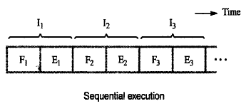
Basic idea of Instruction Pipelining
Sequential Execution of a program
The processor executes a program by fetching(Fi) and executing(Ei) instructions one by one.

Slide 72
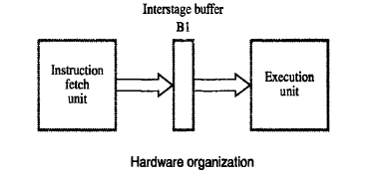
Hardware organization and instruction pipeline
Consists of 2 hardware units one for fetching and another one for execution as follows.
Also has intermediate buffer to store the fetched instruction

Slide 73
TWO Stage Pipeline
Execution of instruction in pipeline manner is controlled by a clock.
In the first clock cycle, fetch unit fetches the instruction I1 and store it in buffer B1.
In the second clock cycle, fetch unit fetches the instruction I2 , and execution unit executes the instruction I1 which is available in buffer B1.
By the end of the second clock cycle, execution of I1 gets completed and the instruction I2 is available in buffer B1.
In the third clock cycle, fetch unit fetches the instruction I3 , and execution unit executes the instruction I2 which is available in buffer B1.
In this way both fetch and execute units are kept busy always.

Slide 74
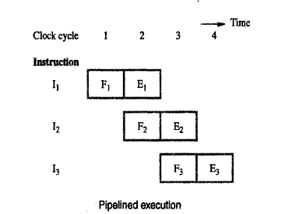
Contd…

Slide 75
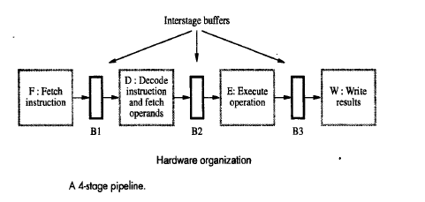
Hardware organization for 4 stage pipeline
Pipelined processor may process each instruction in 4 steps.
Fetch(F): Fetch the Instruction
Decode(D): Decode the Instruction
Execute (E) : Execute the Instruction
Write (W) : Write the result in the destination location
4 distinct hardware units are needed as shown below.

Slide 76
Execution of instruction in 4 stage pipeline
In the first clock cycle, fetch unit fetches the instruction I1 and store it in buffer B1.
In the second clock cycle, fetch unit fetches the instruction I2 , and decode unit decodes instruction I1 which is available in buffer B1.
In the third clock cycle fetch unit fetches the instruction I3 , and decode unit decodes instruction I2 which is available in buffer B1 and execution unit executes the instruction I1 which is available in buffer B2.
In the fourth clock cycle fetch unit fetches the instruction I4 , and decode unit decodes instruction I3 which is available in buffer B1, execution unit executes the instruction I2 which is available in buffer B2 and write unit write the result of I1.

Slide 77
Contd…

Slide 78
Role of cache memory in Pipelining
Each stage of the pipeline is controlled by a clock cycle whose period is that the fetch, decode, execute and write steps of any instruction can each be completed in one clock cycle.
However the access time of the main memory may be much greater than the time required to perform basic pipeline stage operations inside the processor.
The use of cache memories solve this issue.
If cache is included on the same chip as the processor, access time to cache is equal to the time required to perform basic pipeline stage operations .

Slide 79
Pipeline Performance
Pipelining increases the CPU instruction throughput - the number of instructions completed per unit of time.
The increase in instruction throughput means that a program runs faster and has lower total execution time.
Example in 4 stage pipeline, the rate of instruction processing is 4 times that of sequential processing.
Increase in performance is proportional to no. of stages used.
However, this increase in performance is achieved only if the pipelined operation is continued without any interruption.
But this is not the case always.

Slide 80
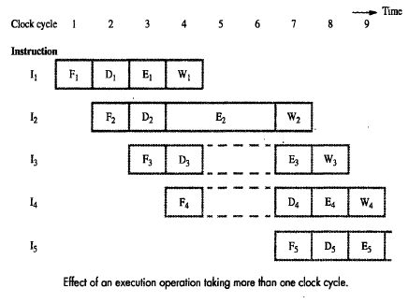
Contd…
Consider the scenario, where one of the pipeline stage may require more clock cycle than the other.
For example, consider the following figure where instruction I2 takes 3 cycles to completes its execution(cycle 4,5,6)
In cycle 5,6 the write stage must be told to do nothing, because it has no data to work with.

Slide 81
What is Pipeline Hazard?
Meanwhile, the information in buffer B2 must remains there until the execute stage has completed.
It shows that stage 2 and stage 1 are blocked from accepting new instructions.
Thus the steps D4 and F5 must be postponed which is shown in the previous figure.
The previous figure shows that the pipelined operations are paused for 2 clock cycles and resumes the pipelined operations in cycle 7.
Any condition that causes the pipeline to pause/stall is called hazard.
Types of hazard:
Data hazard
It is a condition in which either the source or the destination operands are not available at the expected time in the pipeline . The previous figure shows an example or data hazard.
Control or Instruction hazard
It is a condition in which the pipelined operations are paused because of the delay in the availability of an instruction.
Structural hazard
A structural hazard occurs when two (or more) instructions that are already in pipeline need the same resource. The result is that instruction must be executed in series rather than parallel for a portion of pipeline.

Slide 82
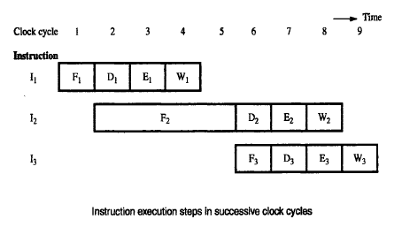
Example for Instruction hazard
The following figure illustrate that, Instruction I1 is fetched from cache in clock cyce1 and its execution proceeds normally.
In clock cyce2, the fetch operation of I2 from cache miss and it suspends the further fetch requests and wait for the arrival of I2.
The figure shows that, I2 arrived and loaded into B1 at the end of clock cyce5. Now the normal pipeline operation resumes.

Slide 83
Contd…
Note that the decode unit is suspended from clock cyce3 to clock cycle5,
The execute unit is suspended from clock cycle4 to clock cycle6
The write unit is suspended from clock cycle5 to clock cycle7
These suspended period is called stalls/bubbles in the pipeline

Slide 84
What is Structural hazard?
This hazard arises in a situation when 2 instruction tries to use the same hardware resources at a time.
Consider a situation, where one instruction may need to access memory either in execute or write stage whereas the other instruction may need to access memory in fetch stage .
Also assumes that the instruction and data are available in cache.
In this scenario, only one instruction can proceed while the other is suspended.
Consider the instruction
I2 : Load X(R1),R2
Here the memory address, X+ [R1] is computed at clock cycle 4, then the memory access takes place in clock cycle 5. (i.e) I2 execution takes 2 clock cycles.

Slide 85
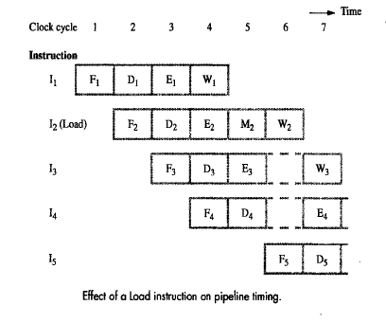
Contd…
It means that memory access at clock cycle 5 is written into register R2 in clock cycle 6.
It causes the pipeline operation is suspended for clock cycle 6, since both I2 and I3 require access to the register file in clock cycle 6.

Slide 86
Important point to consider
It is very important that, pipeline operation does not execute the individual instruction faster, instead it increases the overall performance of program execution
At any point of time, if any one of the stages in pipeline can not complete its operation in one clock cycle, then the pipeline is suspended and some performance degradation occurs.
So the goal is to identify all hazards and find ways to minimize their impact.

Slide 87
Data Hazards
It is a condition in which pipeline is stalled/suspended coz of either the source or the destination operands are not available at the expected time in the pipeline .
Consider the following 2 instruction
I1: A=3+A
I2: B=4*A
When these instructions are executed in pipeline, the result generated by I1 may not be available to I2 , since execution of I2 begins before the completion of I1. As a result, it gives the incorrect result.
In the above example the result of the I1 is taken as the Input to I2. So data dependency arises.
The data dependency may also arises when the destination of one instruction is used as a source in the next instruction.
Example:
I1 : Mul R2,R3,R4 R4= R2*R3
I2 : Add R5,R4,R6 R6=R5+R4

Slide 88
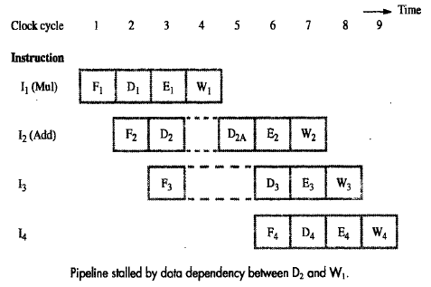
Contd…
The result of Mul instruction is R4, which in turn is used as one of the two source operands of Add instruction.
Assume that the execution unit of Mul instruction takes one clock cycle.
In clock cycle3, when the decode unit of Add instruction realizes that R4 is used as the source operand, it cannot be completed the decoding until the write unit of Mul instruction has been completed.

Slide 89
Contd…
So the completion of D2 must be delayed to clock cycle 5 as shown in the above Figure as D2A.
Instruction I3 is fetched in clock cycle 3, but its decoding is done in clock cycle 6. As shown in the above Figure the pipeline is stalled for two clock cycles.

Slide 90
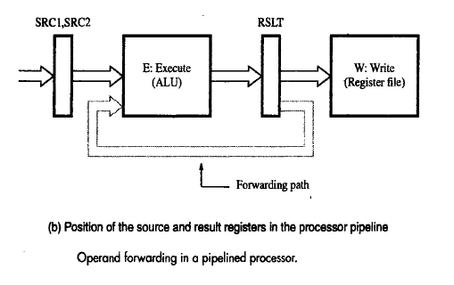
Methods to overcome Data hazards
(Operand Forwarding)
Data hazards occur when instructions that exhibit data dependence
In the previous example, instruction I2 is waiting for data to be written in the register by instruction I1.
However, this data is available at the o/p of ALU once the execution of I1 gets over in the unit E1.
Hence, the delay can be reduced or sometimes eliminated if we rearrange for the result of instruction I1 to be forwarded directly to the step E2.

Slide 91
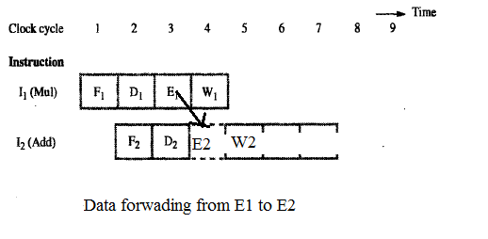
Contd…
After decoding the instruction I2 in clock cycle 3 , the system identifies the data dependency and so a decision is made to use data forwarding.
The operand not involved in the dependency is read and loaded in register SRC1 in clock cycle 3 .
In the next clock cycle , the result produced by I1 is available in the register RSLT (because of data forwarding) can be used in step E2.
Hence execution of I2 proceeds without interruption.

Slide 92
Handling Data hazards in Software
Another approach of identifying data dependencies and dealing with them by using software.
In this case, the compiler can introduce 2 clock cycle delay needed between I1 and I2 by inserting NOP (No OPeration) instructions as follows.
I1 : Mul R2,R3,R4 R4= R2*R3
NOP
NOP
I2 : Add R5,R4,R6 R6=R5+R4

Slide 93
What is implicit dependency and Side Effects of this?
The data dependencies encountered in the previous example is explicit, easily detected and can be resolved.
But this is not the case always, when a location other than one explicitly named in an instruction as a destination operand is affected, then the instruction said to have side effect.
Example1:
Stack instructions such as push and pop produce side effects because they implicitly use auto increment and auto decrement addressing modes.
Example2:
I1 : Add R1,R3
I2 : Add With Carry R2,R4

Slide 94
Contd…
In example 2, an implicit dependency exists between these instructions through carry flag.
The carry flag set by the first instruction is used in the second instruction which performs R4=[R2]+[R4]+carry.
The instructions that have side effects give rise to multiple data dependencies which lead to the increase in both the hardware and software needed to resolve them.
So, the instructions which are executed in pipeline manner should have few side effects.

Slide 95
Instruction Hazards
Whenever the stream of instructions supplied by the instruction fetch unit is interrupted, the pipeline stalls.

Slide 96
Unconditional Branches
Sequence of instruction being executed in two stages pipeline instruction I1 to I3 are stored at consecutive memory address and instruction I2 is a branch instruction.
If the branch is taken then the PC value is not known till the end of I2.
Next three instructions are fetched even though they are not required
Hence they have to be flushed after branch is taken and new set of instruction have to be fetched from the branch address

Slide 97
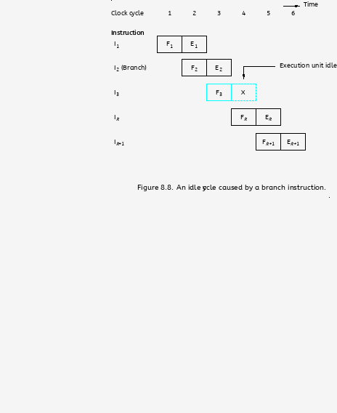
Unconditional Branches

Slide 98
Branch Timing
Branch penalty
The time lost as the result of branch instruction
Reducing the penalty
The branch penalties can be reduced by proper
scheduling Through compiler techniques
For longer pipeline,the branch penalty may be higher
Reducing the branch penalty requires branch address to be computed earlier in the pipeline
Instruction fetch unit has dedicated hardware
to identify a branch instruction and compute branch target address as quickly as possible after an instruction is fetched

Slide 99
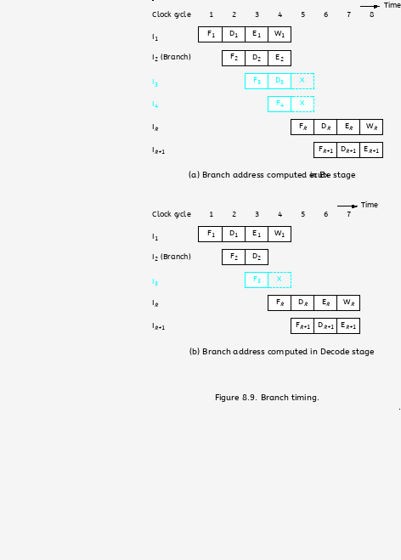
Branch Timing

Slide 100
Branch Timing

Slide 101
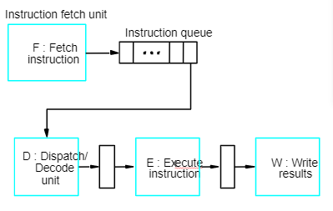
Instruction Queue and Prefetching

Slide 102
Instruction Queue and Prefetching
Fetch Unit-Contain instruction queue to store the instruction before the are needed to avoid interruption
Dispatch unit-Takes instruction from the front of the queue and sends them to the execution unit, it also perform the decoding operation
Fetch unit keeps the instruction queue filled at all times, fetch instrution and add them to the queue.
If there is delay in fetching the instrution,the dispatch unit continues to issue the instruction from the instruction queue

Slide 103
Conditional Branches
A conditional branch instruction introduces the added hazard caused by the dependency of the branch condition on the result of a preceding instruction.
The decision to branch cannot be made until the execution of that instruction has been completed.
Branch instructions represent about 20% of the dynamic instruction count of most programs.

Slide 104
Delayed Branch
The instructions in the delay slots are always fetched. Therefore, we would like to arrange for them to be fully executed whether or not the branch is taken.
The objective is to place useful instructions in these slots.
The effectiveness of the delayed branch approach depends on how often it is possible to reorder instructions.

Slide 105
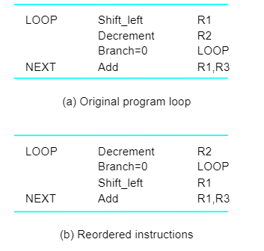
Delayed Branch

Slide 106
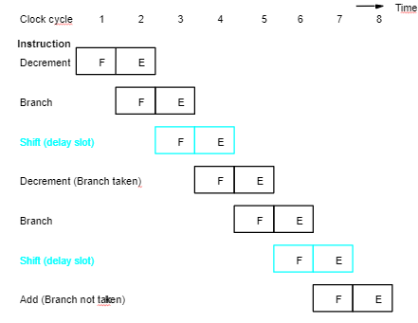
Delayed Branch

Slide 107
Branch Prediction
To predict whether or not a particular branch will be taken.
Simplest form: assume branch will not take place and continue to fetch instructions in sequential address order.
Until the branch is evaluated, instruction execution along the predicted path must be done on a speculative basis.
Speculative execution: instructions are executed before the processor is certain that they are in the correct execution sequence.
Need to be careful so that no processor registers or memory locations are updated until it is confirmed that these instructions should indeed be executed.

Slide 108
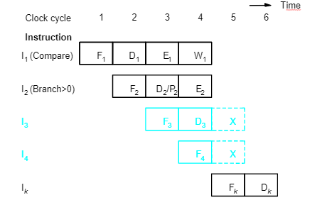
Incorrectly Predicted Branch

Slide 109
Branch Prediction
Better performance can be achieved if we arrange for some branch instructions to be predicted as taken and others as not taken.
Use hardware to observe whether the target address is lower or higher than that of the branch instruction.
Let compiler include a branch prediction bit.
So far the branch prediction decision is always the same every time a given instruction is executed – static branch prediction.

Slide 110
Branch Prediction
Static Prediction
Dynamic branch Prediction

Slide 111
Static Prediction
Prediction is carried out by compiler and it is static because the prediction is already known before the program is executed

Slide 112
Dynamic Branch Prediction
Dynamic prediction in which the prediction decision may change depending on the execution history

Slide 113
Branch Prediction Algorithm
If the branch taken recently,the next time if the same branch is executed,it is likely that the branch is taken
State 1: LT : Branch is likely to be taken
State 2: LNT : Branch is likely not to be taken
1.If the branch is taken,the machine moves to LT. otherwise it remains in state LNT.
2.The branch is predicted as taken if the corresponding state machine is in state LT, otherwise it is predicted as not taken

Slide 114
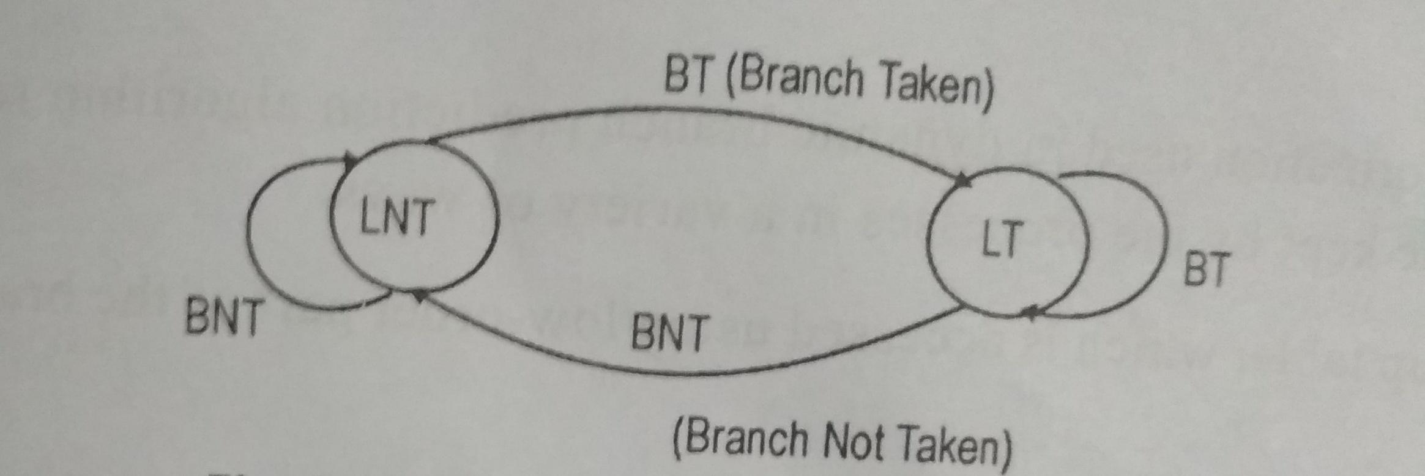
Branch Prediction Algorithm

Slide 115
4 State Algorithm
ST-Strongly likely to be taken
  LT-Likely to be taken
  LNT-Likely not to be taken
  SNT-Strongly not to be taken
Step 1: Assume that the algorithm is initially set to LNT
Step 2: If the branch is actually taken changes to ST, otherwise it is changed to SNT.
Step 3: when the branch instruction is encountered, the branch will taken if the state is either LT or ST and begins to fetch instruction at branch target address, otherwise it continues to fetch the instruction in sequential manner

Slide 116
4 State Algorithm
When in state SNT,the instruction fetch unit predicts that the branch will not be taken
If the branch is actually taken,that is if the prediction is incorrect,the state changes to LNT

Slide 117
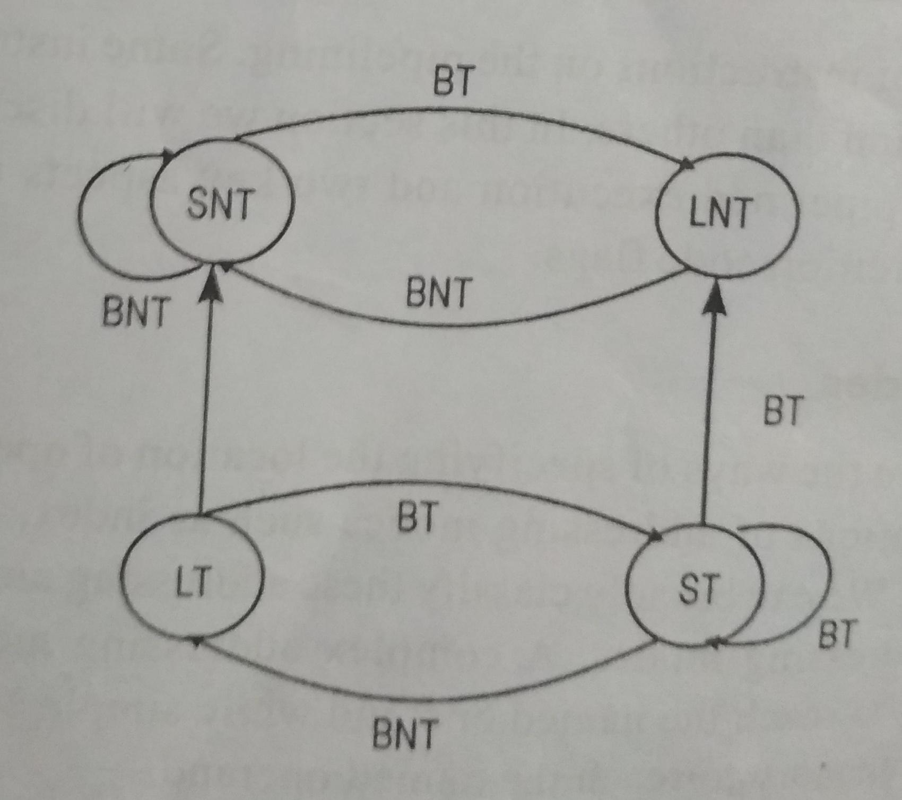
4 State Algorithm

Slide 118
CONTROL HAZARDS

Slide 119
CONTROL HAZARDS
A Control Hazard occurs if there is a control instruction(e.g.BEQ) because the program counter(PC) following the control instruction is not known until the control instruction is computes if the branch should be taken or not.
If branch taken,then need to zap/flush instructions.
There is a performance penalty for branches:
Need to stall,then may ned to zap(flush)
Subsequent instructions that have already been fetched.

Slide 120
Contd…
Control Hazards
Instructions are fetched in stage 1(IF)
Branch and jump decisions occur in stage 3(EX)
i.e. Next PC is not known until 2 cycles after
branch/jump
Can optimize and move branch and jump decision to
stage 2
i.e. Next PC is not known until 1 cycles after
branch/jump

Slide 121
Contd…
Stall(+Zap)
Prevent PC update
Clear IF/ID pipeline register
- Instruction just fetched might be wrong one,so
convert to nop
Allow branch to continue into EX stage
We can reduce cost of a control hazard by moving
branch decision and calculation from EX stage to ID
stage.This reduces the cost from flushing two
instructions to only flushing one.

Slide 122
Contd…
ISA says N instructions after branch/jump always
executed
- MIPS has 1 branch delay slot
- i.e. Whether branch taken or not, instruction following branch is always executed
Delay Slots can potentially increase performance due to
control hazards by putting a useful instruction in the
delay slot since the instruction in the delay slot will
always be executed.
Require software (compiler) to make use of delay slot.
Put NOP in delay slot if not able to put useful instruction
in delay slot.

Slide 123
Contd…
Pipelining and branching don’t get along
Transfer of control (jumps, procedure call/returns,
successful branches) cause control hazards
When a branch is known to succeed, at the Mem stage
(but could be done one stage earlier), there are
instructions in the pipeline in stages before Mem that
- need to be converted into “no-op”
- and we need to start fetching the correct instructions by using the right PC

Slide 124
Contd…
Branches(conditional, unconditional, call-return)
Interrupts : asynchronous event(e.g.,I/O)
- Occurrence of an event checked at every cycle
- If an interrupt has been raised, don’t fetch next instruction, flush the pipe, handle the interrupt
Exceptions(e.g., arithmetic overflow, page fault
etc.,)
- Program and data dependent(repeatable),
hence”synchronous”

Slide 125
RESOLVING CONTROL HAZARDS
Detecting a potential control hazard is easy
- Look at the opcode
We must insure that the state of the program is not
changed until the outcome of the branch is known.
Possibilities are:
- Stall as soon as opcode is detected(cost 3 bubbles; same type of logic as for the load stall but for 3 cycles instead of 1)
- Assume that branch won’t be taken(cost only if branch is taken)
- Use some predictive techniques

Slide 126
INFLUENCE ON INSTRUCTION SETS

Slide 127
OVERVIEW
Some instructions are much better suited to pipeline
execution than others.
Addressing modes
Conditional code flags

Slide 128
ADDRESSING MODES
Addressing modes include simple ones and complex
ones.
In choosing the addressing modes to be implemented in
a pipelined processor, we must consider the effect of
each addressing mode on instruction flow in the
pipeline:
- Side effects
- The extent to which complex addressing modes cause the pipeline to stall
- Whether a given mode is likely to be used by compilers

Slide 129
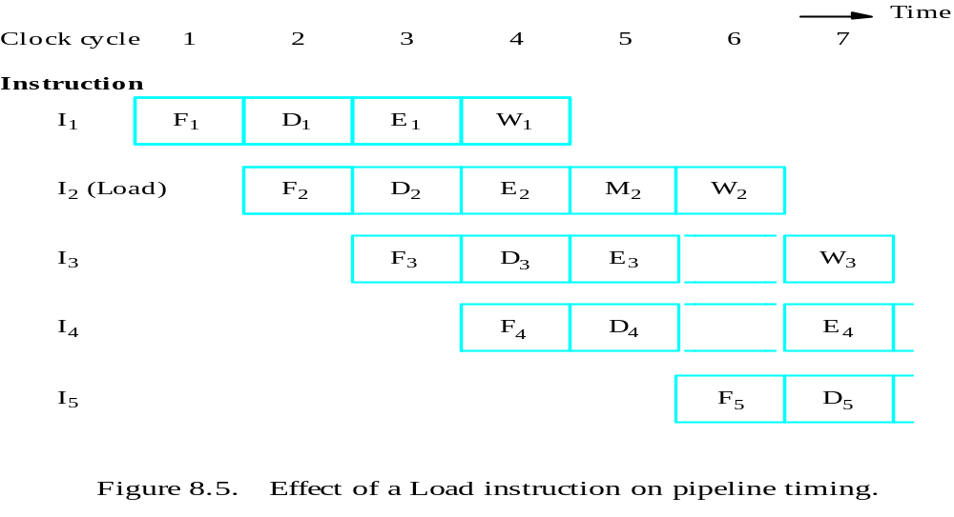
RECALL
Load X(R1), R2
Load (R1), R2

Slide 130
COMPLEX ADDRESSING MODE
Load (X(R1)), R2
Clock cycle
T
ime
1
2
3
4
5
6
7
Load
F
D
X
+
[R1]
[X
+
[R1]]
[[X
+
[R1]]]
W
F
orw
ard
Ne
xt instruction
F
D
E
W
(a) Complex addressing mode

Slide 131
SIMPLE ADDRESSING MODE
Add #X, R1, R2
Load (R2), R2
Load (R2), R2
Add
F
D
X
+
[R1]
W
Load
F
D
[X
+
[R1]]
W
Load
F
D
[[X
+
[R1]]]
W
Ne
xt instruction
F
D
E
W
(b) Simple addressing mode

Slide 132
ADDRESSING MODES
In a pipelined processor, complex addressing modes do
not necessarily lead to faster execution.
Advantage: reducing the number of instructions /
program space
Disadvantage: cause pipeline to stall / more hardware
to decode / not convenient for compiler to work with
Conclusion: complex addressing modes are not suitable
for pipelined execution.

Slide 133
ADDRESSING MODES
Good addressing modes should have:
- Access to an operand does not require more than one access to the memory
- Only load and store instruction access memory operands
- The addressing modes used do not have side effects
Register, register indirect, index

Slide 134
CONDITIONAL CODES
If an optimizing compiler attempts to reorder instruction
to avoid stalling the pipeline when branches or data
dependencies between successive instructions occur, it
must ensure that reordering does not cause a change in
the outcome of a computation.
The dependency introduced by the condition-code flags
reduces the flexibility available for the compiler to
reorder instructions.

Slide 135
CONDITIONAL CODES
Add
Compare
Branch=0
R1,R2
R3,R4
. . .
a) A program fragment
Compare
Add
Branch=0
R3,R4
R1,R2
. . .
b) Instructions reordered
Instruction reordering

Slide 136
CONDITIONAL CODES
Two conclusion:
To provide flexibility in reordering instructions, the
condition-code flags should be affected by as few
instruction as possible.
The compiler should be able to specify in which
instructions of a program the condition codes are
affected and in which they are not.

